Slide 1
Restaurant Presentation

Slide 2
Team Members 1-Mohamed Ibrahim Belal . 2303210 2-Hatem Emad Refaat . 2301763 3-Retaj Mohammed Gaber . 2301390 4-Merna Khaled Abdelaziz . 2302268 5-Eman Ahmed Arafa . 2302269 6-Engy Adell Ali . 2302133 7-Menna tarrahman Yahia Saif Al deen . 2302823 8-Mariem Mahmoud dadeesh . 2202924

Slide 3
Introduction
The aim of the project is to create a simple and user-friendly website for a restaurant, featuring sections such as the menu, about us, contact information, and table reservations . We built the project using core web development technologies including HTML, CSS, and JavaScript, along with additional tools/libraries to enhance the design and functionality .

Slide 4
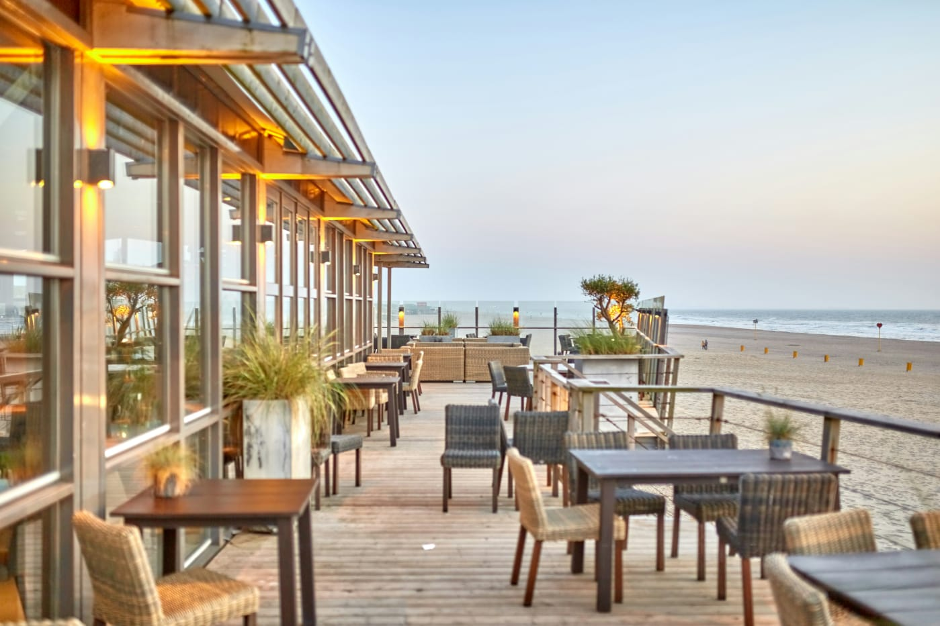
Website Link You can visit our restaurant website from the link below: https://eman135375.github.io/restaurant/

Slide 5

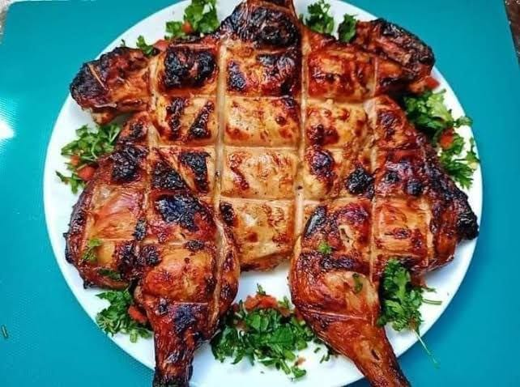
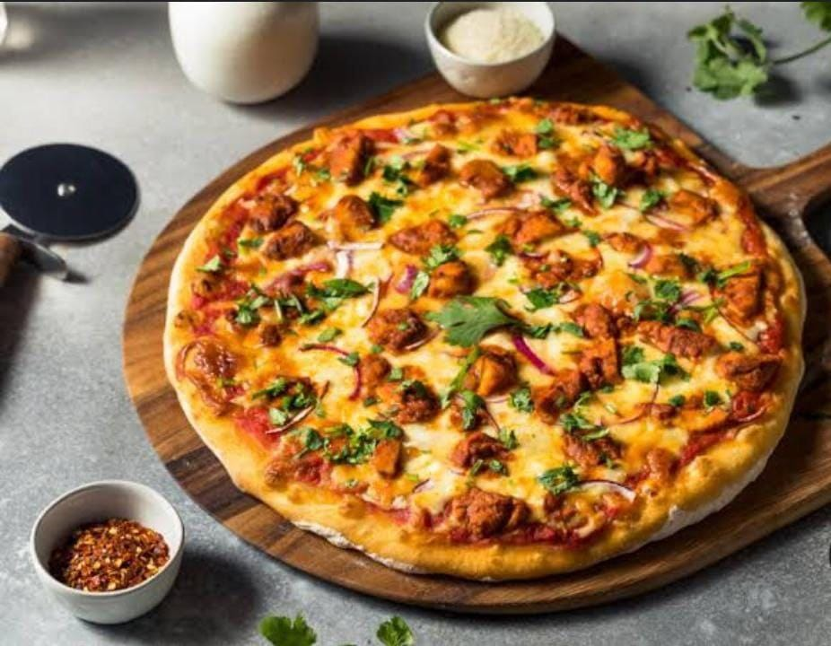
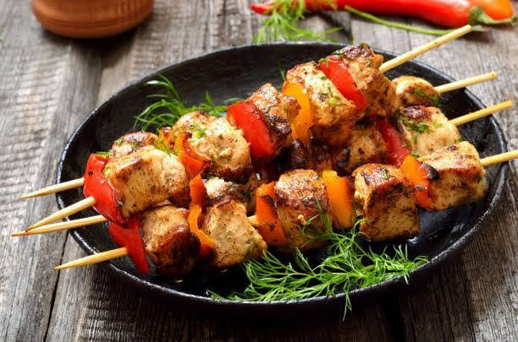

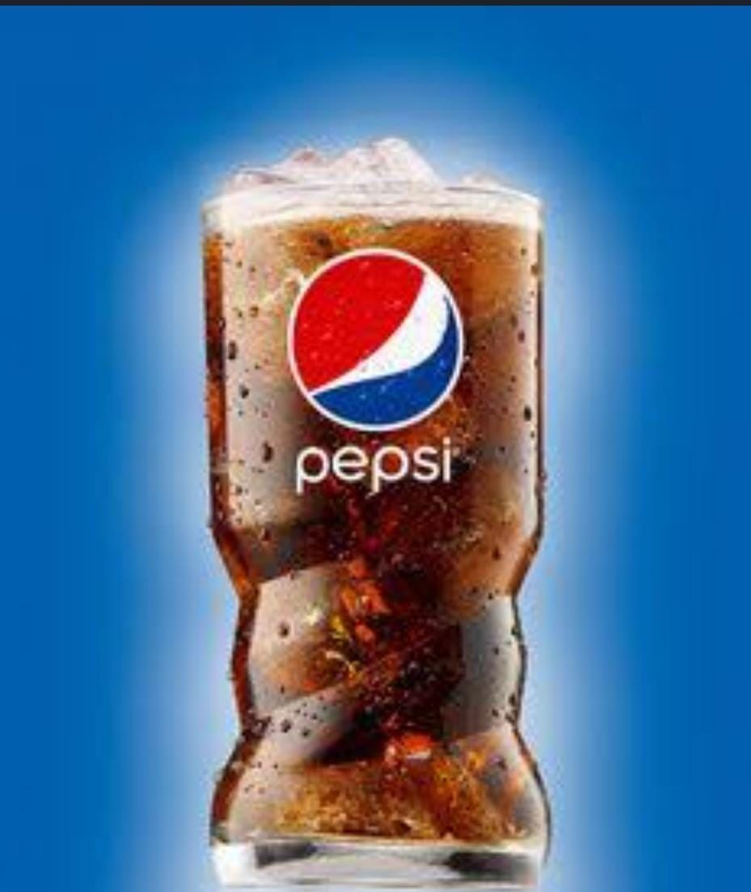

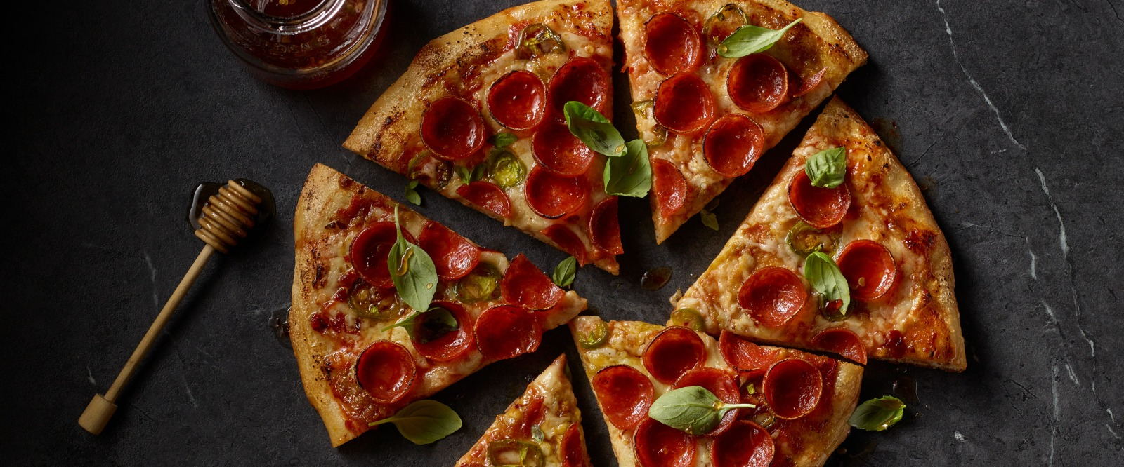
Pictures Codes

Slide 6
Thank You

